Slide 1
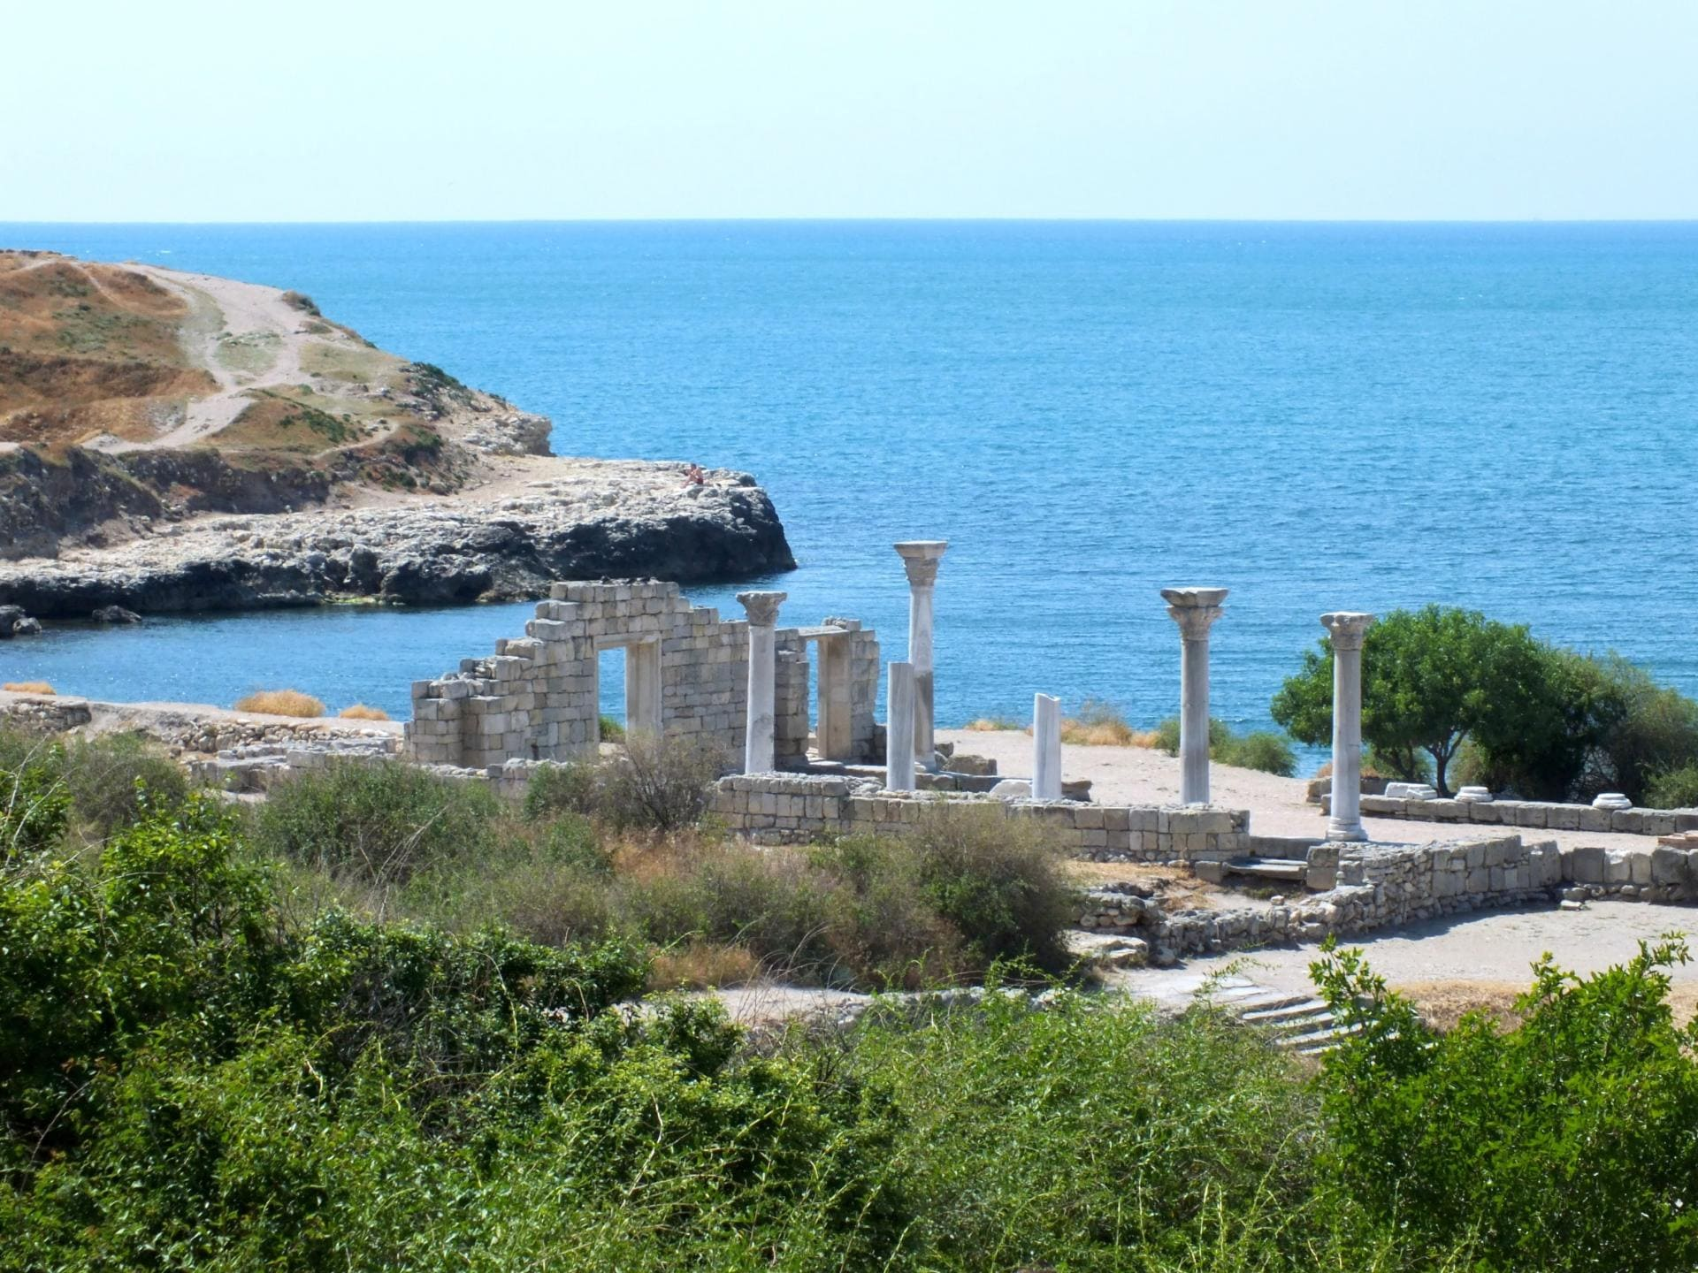
Crimea and Russia:
Crimea is a beautiful peninsula located near the Black Sea. It has a very interesting history!
by Valentina Airiyan

Slide 2
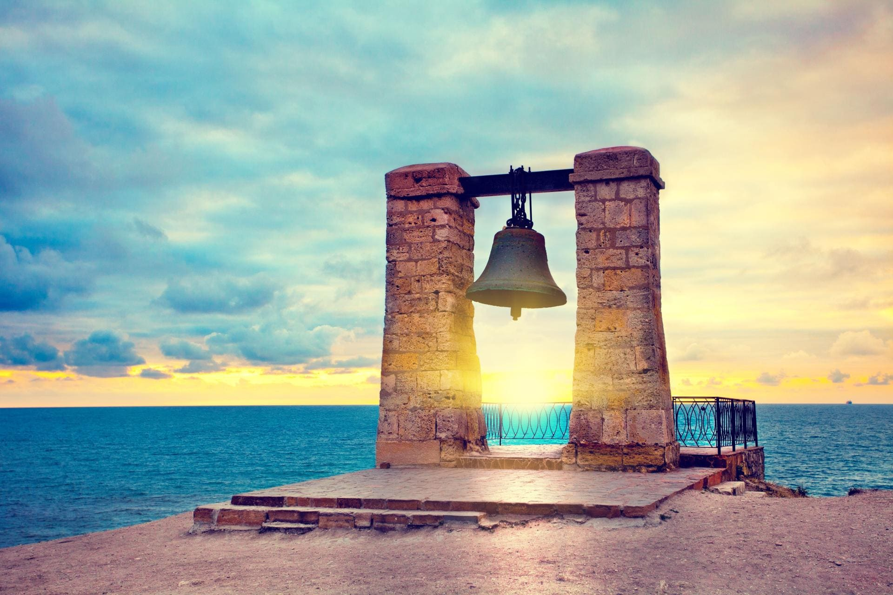
A Short history
Crimea has a very long and interesting history.
Timeline of events before the famous event.
Ancient Times
The 13th century
Middle Ages
In 1783
First Joining Russia
The 20th century
In 1954
was given to Ukraine SSR
Modern Times
In 2014
became part of Russia again

Slide 3
Let’s learn a little about the history of Crimea. Crimea has been A part of different countries and cultures
Ancient Times: Long ago, Crimea was home to different groups of people, like the Tauri and Scythians. Later, the Ancient Greeks came and built cities there.
Middle Ages: In the 13th century, the Mongols and the Golden Horde ruled Crimea. After that, the Crimean Khanate was formed, and it became a powerful state.
First Joining Russia: In 1783, Crimea became part of Russia for the first time. This happened under the rule of Catherine the Great, a famous Russian queen.
20th Century: In 1954, Crimea was given to Ukraine by the Soviet Union. At that time, Ukraine and Russia were part of the same country, the USSR.
Modern Times: In 2014, Crimea became part of Russia again after a referendum (a vote by the people).

Slide 4
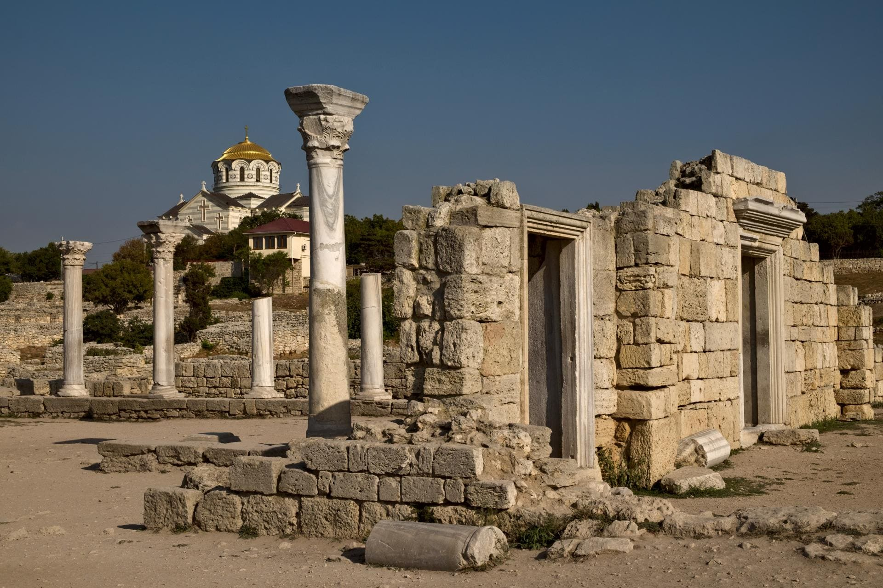
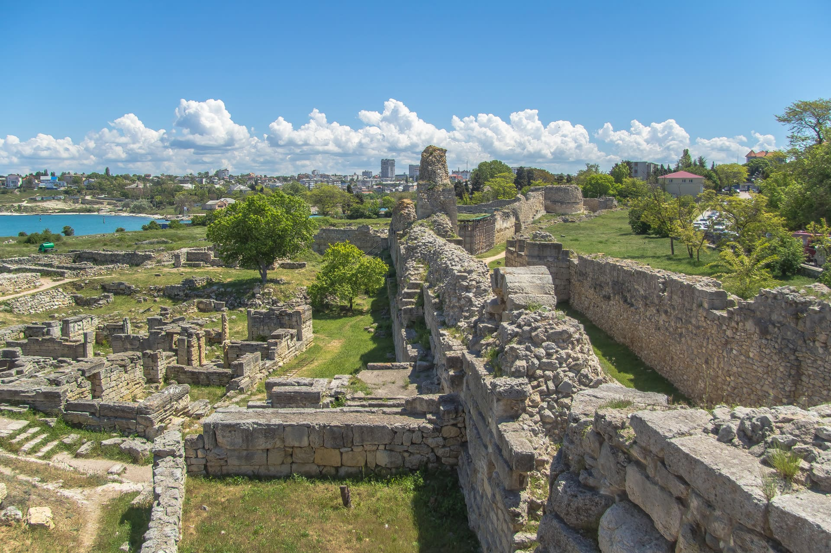
Ancient Times:
Long ago, Crimea was home to different groups of people, like the Tauri and Scythians. Later, the Ancient Greeks came and built cities there.
This is what the ancient cities that the Greeks built in Crimea were like!

Slide 5
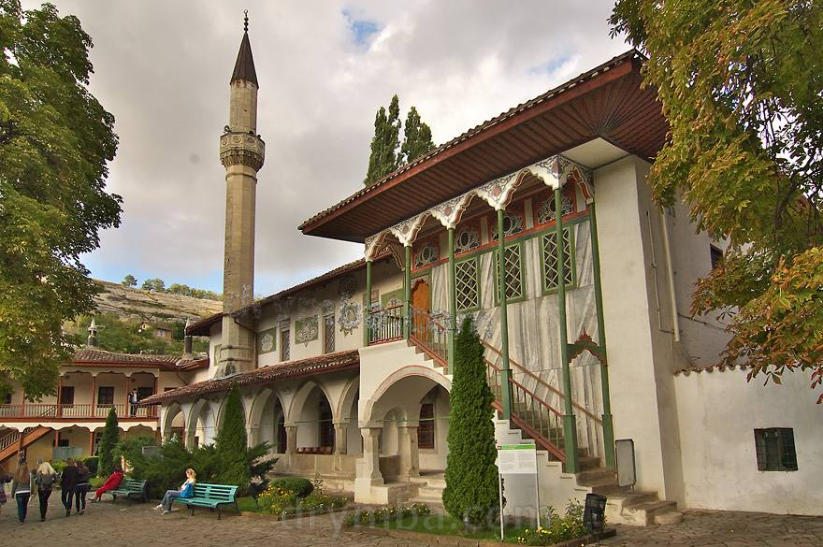
Middle Ages:
In the 13th century, the Mongols and the Golden Horde ruled Crimea. After that, the Crimean Khanate was formed, and it became a powerful state.
"This is the palace of the Crimean khans who ruled Crimea many years ago."

Slide 6
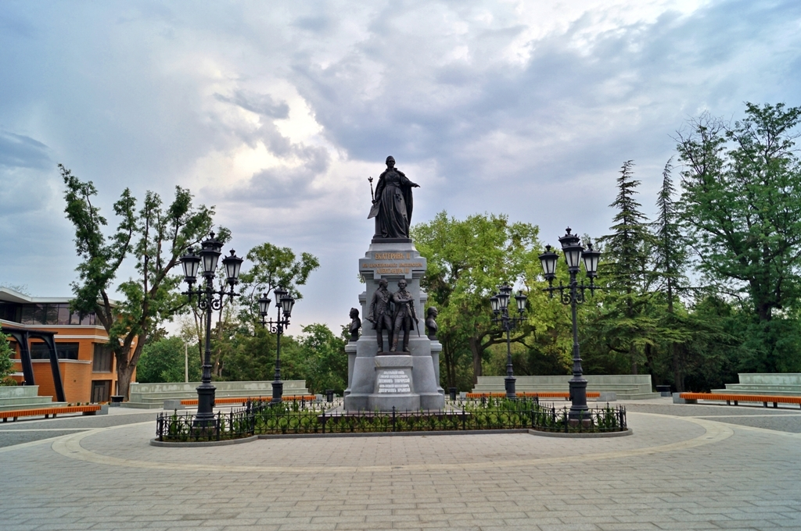
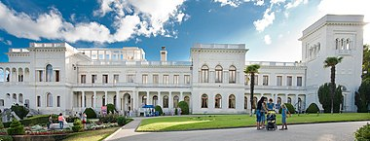
First Joining Russia:
In 1783, Crimea became a part of Russia for the first time. This happened under the rule of Catherine the Great, a famous Russian queen.
"Empress Catherine the Great made Crimea part of Russia in 1783."

Slide 7
From February 4 to February 11, 1945, the Yalta Conference of the leaders of the 3 allied powers was held in the Livadia Palace: the USSR, the USA, Great Britain (J. V. Stalin, F. D. Roosevelt, W. Churchill). the American delegation headed by President Roosevelt also once lived there.

Slide 8
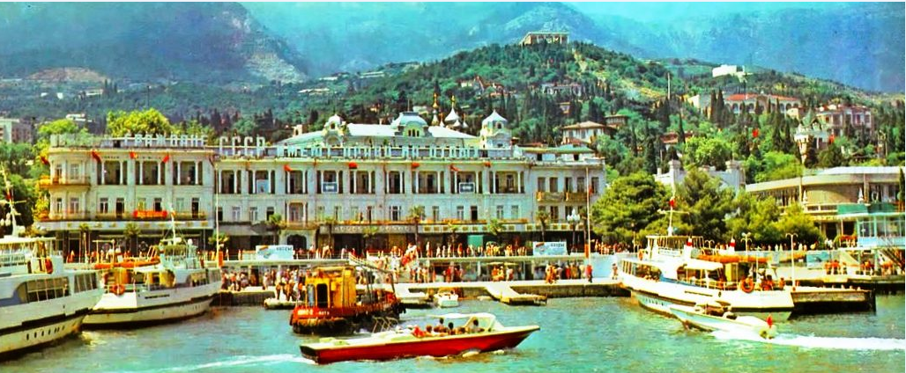
"In 1954, Crimea became a part of Ukraine SSR, back when Ukraine and Russia were one country — the USSR."

Slide 9
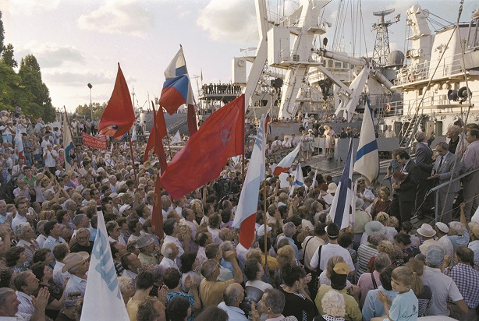
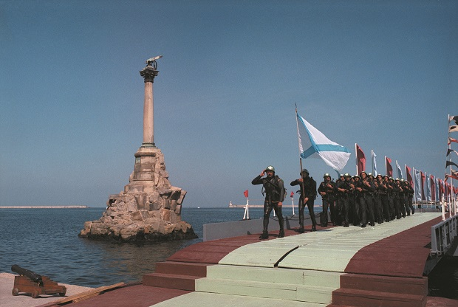
After the Soviet Union (1991)
In 1991, the Soviet Union ended, and Ukraine became an independent country. Crimea stayed a part of Ukraine, but many people there still felt close to Russia.
Russia kept its naval base in Sevastopol, a city in Crimea.

Slide 10
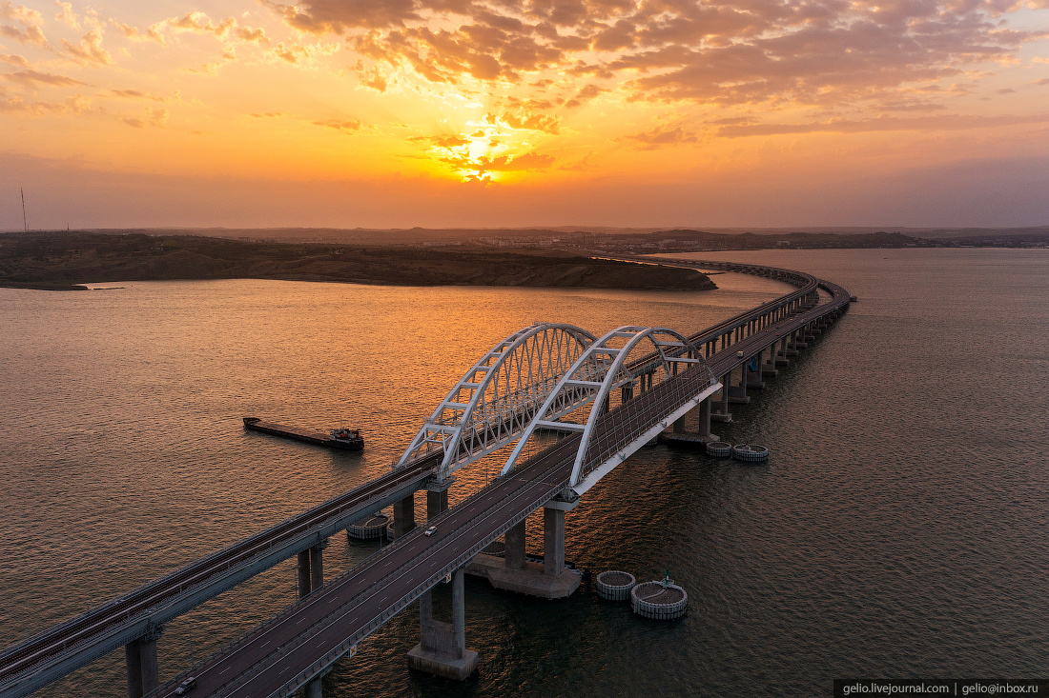
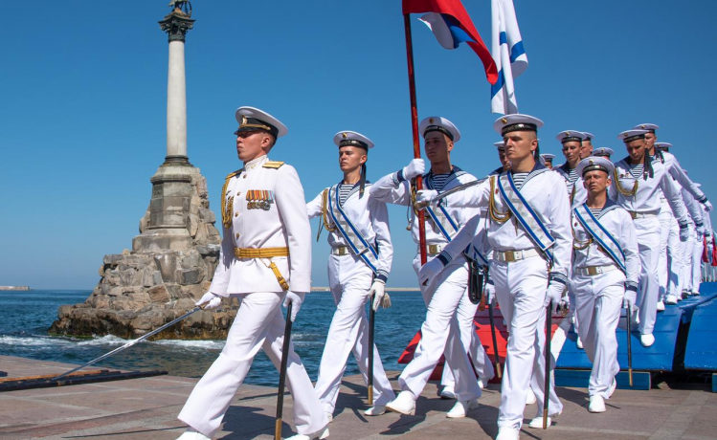
Modern Times:
In 2014, Crimea became a part of Russia again after a referendum (a vote by the people).

Slide 11
Crimea and Russia are connected by centuries-old history, culture and geography. Crimea has always been a strategic, cultural and tourist region
for Russia.

